Slide 1
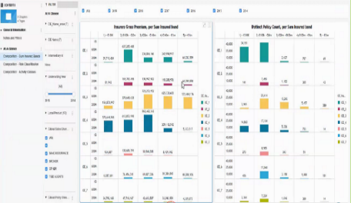
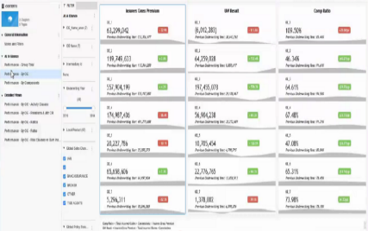
MIS enables an harmonized steering of the MidCorp business
Global Data Platform delivers required functionalities for MIS
Key success factors for MIS MidCorp
Source data
OE data source systems
MidCorp MIS dashboards
Usage of the solution on local level to steer the MidCorp business
Underwriting WB / ITMP
Global Data Platform
Radar live
Financial data
Improvement of local data quality
Nat Cat
LCE 360
GDP as single platform for integration of all data sources for MidCorp business
All data connected to GDP through proper Data Management
Common source of truth
Automation of data ingestion
Reduced reporting efforts
Increased update frequency

Slide 2
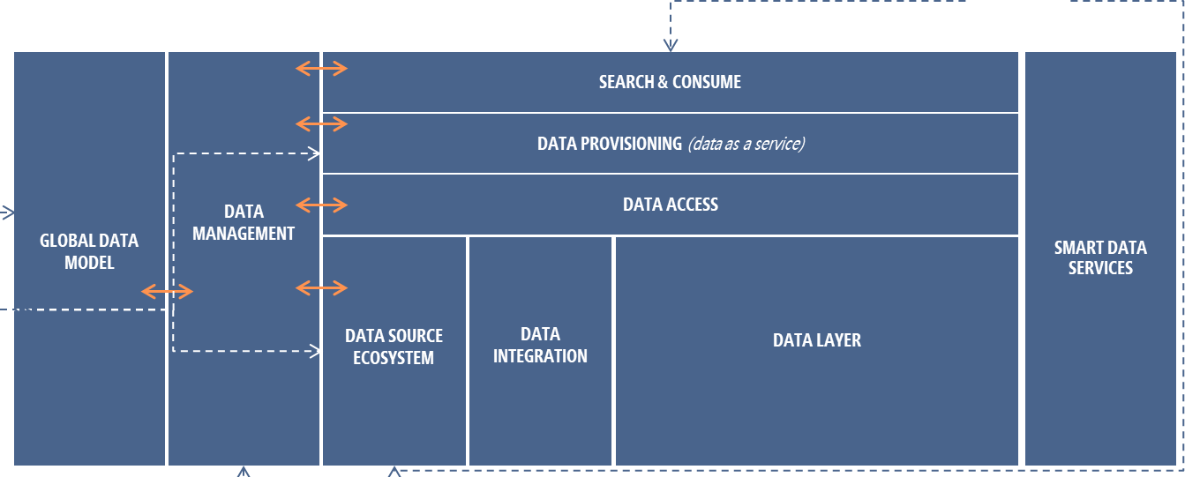
GDP as key enabler for MIS MidCorp
MIS MidCorp
Underwtiring Workbench / MCP
Radar Pricing
LCE 360
OE Core System
Solvency2 Database
OE Finance System
CAT DWH
Source Systems will be connected to GDP by integrating them with Data Management
With the recorded information, GDP will be connected to Source system and data will be ingested
Data ingested into GDP are stored first within raw layer, from there, data are processed according to the business definition into other data and provided to end user in the search & Consume layer
Data lineage is ensured via Data Management, so every data point provided to MIS MidCorp users can be tracked up to the source data elements
MIS MidCorp established in the search and consume layer for Dashboards
Additional integration with GIS and Radar is going to be facilitated via Smart Data Services.
More use cases for MIS MidCorp will be added when available

Slide 3


GDP developments aim to deliver required functionalities and automatize end-to-end Midcorp data management
MIS MidCorp target architecture (simplified view)
Data Governance*
End User Consumption
Elements available for MIS MidCorp (“Lift & Shift”)
GDP Provisioning Layer
Configuration required for First release (based on AZ Re requirements)
Glossary
Catalog/ Dictionary
Virtualization for consumption
Technological evolutions to be delivered
GDP Data Layer (only relevant zones shown)
Business terms to Technical
Mapping
Schema to Schema Mappings
Consumption
Reference Data Management Tool
Reads
MidCorp Harmonized model
Ingestion service
Data quality module
Source connector
Data Stream
Sink Connector
Raw
1:1 with Source
Archive
Long Term Storage
Automatized ingestion model
Automatic ingestion (with Pilot OEs)
Flat files from OEs
* Service available. MidCorp environment mapping ongoing

Slide 4
Appendix

Slide 5
MIS TO BE DELIVERED BY LEVERAGING SELECTED CAPABILITIES FROM TARGET DATA ARCHITECTURE
GLOBAL DATA MODEL
DATA MANAGEMENT
SEARCH & CONSUME
SMART DATA
SERVICES
Data Governance
Visualization & Reporting
Exploring / Discovering
Services Marketplace
Business Glossary
Access to AI solutions / enablers
AI Business Solutions
Data Ownership
DATA PROVISIONING (data as a service)
Fraud
Data Dictionary & Catalogue
Pricing
Data Lineage
Service layer
Knowledge Graph generation /
Semantic layer/ Virtualization
AI semantic feature layer
Reserving
Steering
Claims Lifecycle
Data usage
DATA ACCESS
Next Best Action
Ontology
Data Quality Management
IoT
Business concepts
Data profiling
Authorization check
Policy and compliance governor
…
Events
Quality rules & monitoring
Services
Business capabilities
Quality remediation
DATA SOURCE ECOSYSTEM
DATA INTEGRATION
DATA LAYER
GIS
Reference data
Quality metrics & reporting
Transactional Automation
Ontology Engineering
Metadata Management
Publish
Ingest
Analyzing/ machine learning
Standards and design
Metadata Ownership
Cognitive text/ NLP
Metadata Modelling
Data Tagging
Data science lab
…
Metadata Harvesting
Fully integrated sources
Consumption
Data processing services
Metadata Tagging
Master platform
Error management
KYC – Dynamic Customer Profile
Real time pricing
Mid Corp
…
Encryption
Master Data Management
Connected sources
Anonymization
Standardization
Transform
Entity Resolution
Validation
Wiki data
Refined
Profiling
Survivorship
Other internal & external sources
Transport
Enterprise Data Schema
Quality rules
Business rules
Data Lifecycle Management
CDC data extraction
Transformational rules
Data retention
Raw Zone
Best before date
Raw Source Data
(MP)
API-Enabled services
Information Security
Connectors/ adapters
AI Models repository
Authentication/ authorization
AI-Ops
Encryption/ key management
Curation
Business Rules Engine
Data Privacy
Compute On-prem + Cloud
Audit & Reporting
Scheduling

